Slide 1
INTRODUCTION TO JAVA
DAY 1

Slide 2
BASICS OF JAVA
First name : Oak language
A product of Sun Microsystems
Father of java language: James Gosling
oak language was renamed as java
Java is a object oriented programming (OOP) language.

Slide 3
JAVA – OOPs LANGUAGE
Java is intersection of c and c++.java follows the c- language w.r.t syntaxes.java will follow the c++ language by supporting OOPs concepts.
JAVA runs on these basis of OOPs :
object
class
data hiding
Encapsulation
Data Abstraction
Inheritance
polymorphism

Slide 4
JVM,JDK and JRE
JDK - develop and execute(run) the Java program
JRE - only run(not develop) the java program(or application)- End users of the application
JVM - executing the java program line by line hence it is also known as interpreter. Java Virtual Machine: Physically doesn’t exist. Each OS has different JVM. Platform dependent.Hence java is a platform independent language.
JIT Compiler:
The JIT compiler aids in improving the performance of Java programs by compiling bytecode into native machine code at run time.
The JIT compiler is enabled throughout, while it gets activated, when a method is invoked. For a compiled method, the JVM directly calls the compiled code, instead of interpreting

Slide 5
DATATYPES AND VARIABLES
The amount of memory a variable takes is depending on its datatype.
Types of Datatypes:
Primitive:
byte(1B),short(2B),int(4B),long(8B),float(4B),double(8B),char(2B),boolean(1b)
Non-Primitive:
Array,String,Class,Interface.
ARRAYS: they are used to store multiple values in a single variable, instead of declaring separate variables for each value.
Variable Naming conventions:
Can start with $ or _; Camel casing preferred; eg:contactNumber / variableName. Variable names are case sensitive in Java.
*Types of variables:
Static variable: common for all the instances of the class.
Instance variable: unique for every instance of the class.
Local variable: Scope is only within the method

Slide 6
OPERATORS IN JAVA
Arithmetic Operator (+, -, *, /, %)
Relational Operator (>, <, >=, <=, ==, !=, !)
conditional operator (? :)
Logical Operator (&, |, &&, ||, ^)
Unary Operator 1) Increment 2) Decrement

Slide 7
LOOPS IN JAVA
FOR loop
for (initialization condition; testing condition; increment/decrement)
{ statement(s) }
do…while loop
do
{ statement(s) }
while (condition(s))
While loop
While (condition(s))
{ statement(s) }

Slide 8
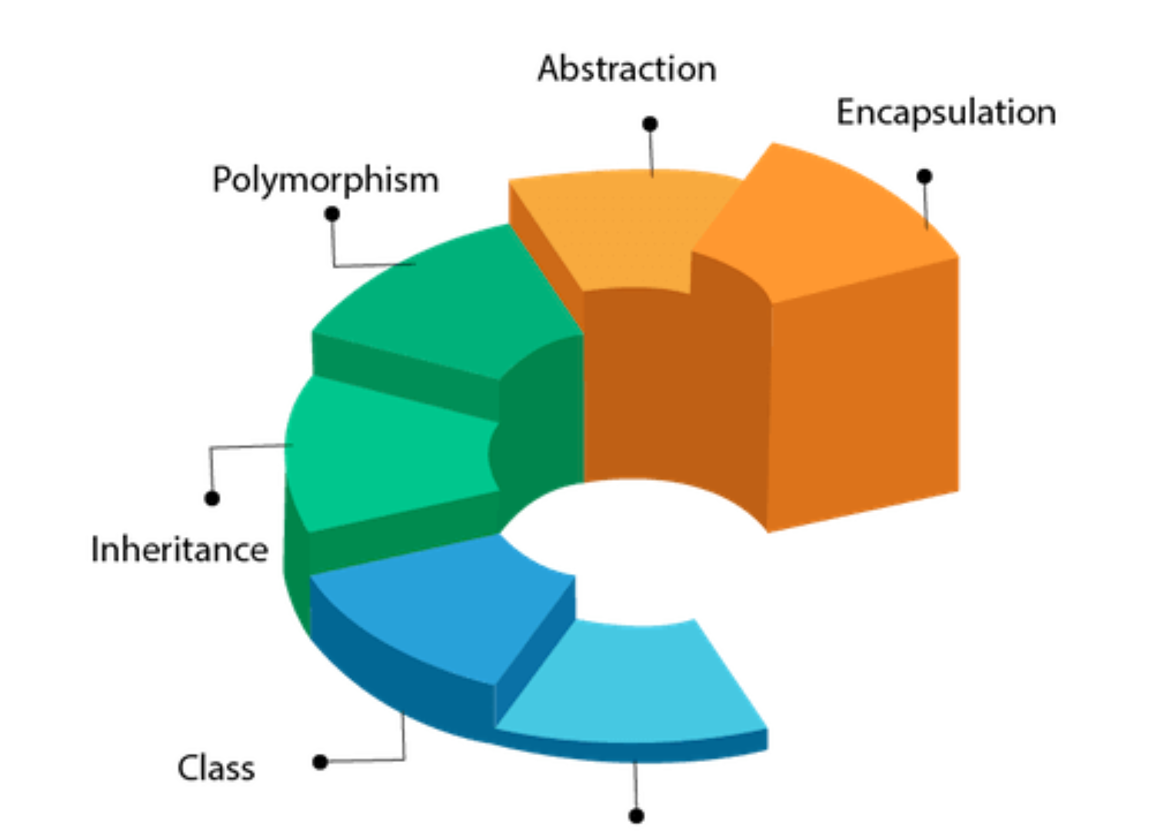
OOPs IN JAVA
Object-Oriented Programming is a paradigm that provides many concepts, such as inheritance, data binding, polymorphism, etc.
The popular object-oriented languages are Java, C#, PHP, Python, C++, etc.
The main aim of object-oriented programming is to implement real-world entities, for example, object, classes, abstraction, inheritance, polymorphism, etc.

Slide 9
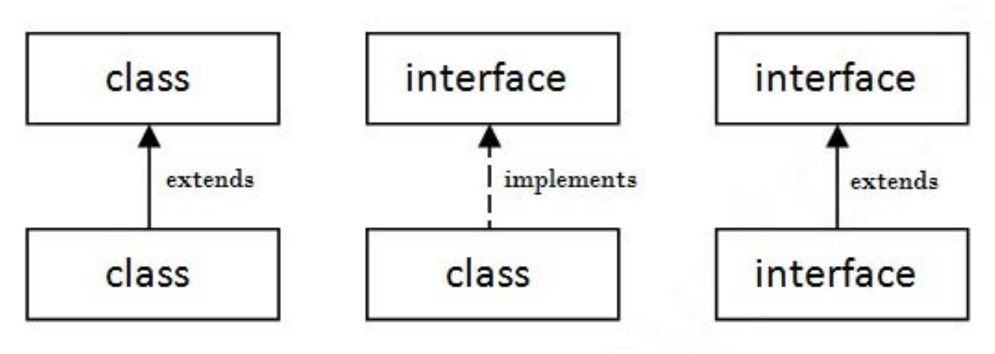
INTERFACES/CLASSES
An interface in Java is a blueprint of a class. It has static constants and abstract methods.
The interface in Java is a mechanism to achieve abstraction.
There can be only abstract methods in the Java interface, not method body.
It is used to achieve ABSTRACTION and MULTIPLE INHERITANCE in java.

Slide 10
JAVA COLLECTIONS
The Collection in Java is a framework that provides an architecture to store and manipulate the group of objects. A Collection represents a single unit of objects, i.e., a group.
The Collection framework represents a unified architecture for storing and manipulating a group of objects.
It has:
Interfaces and its implementations, i.e., classes
Algorithm
Collections are mainly divided into 5 types:
List
Queue
Deque
Set
Sorted Set

Slide 11
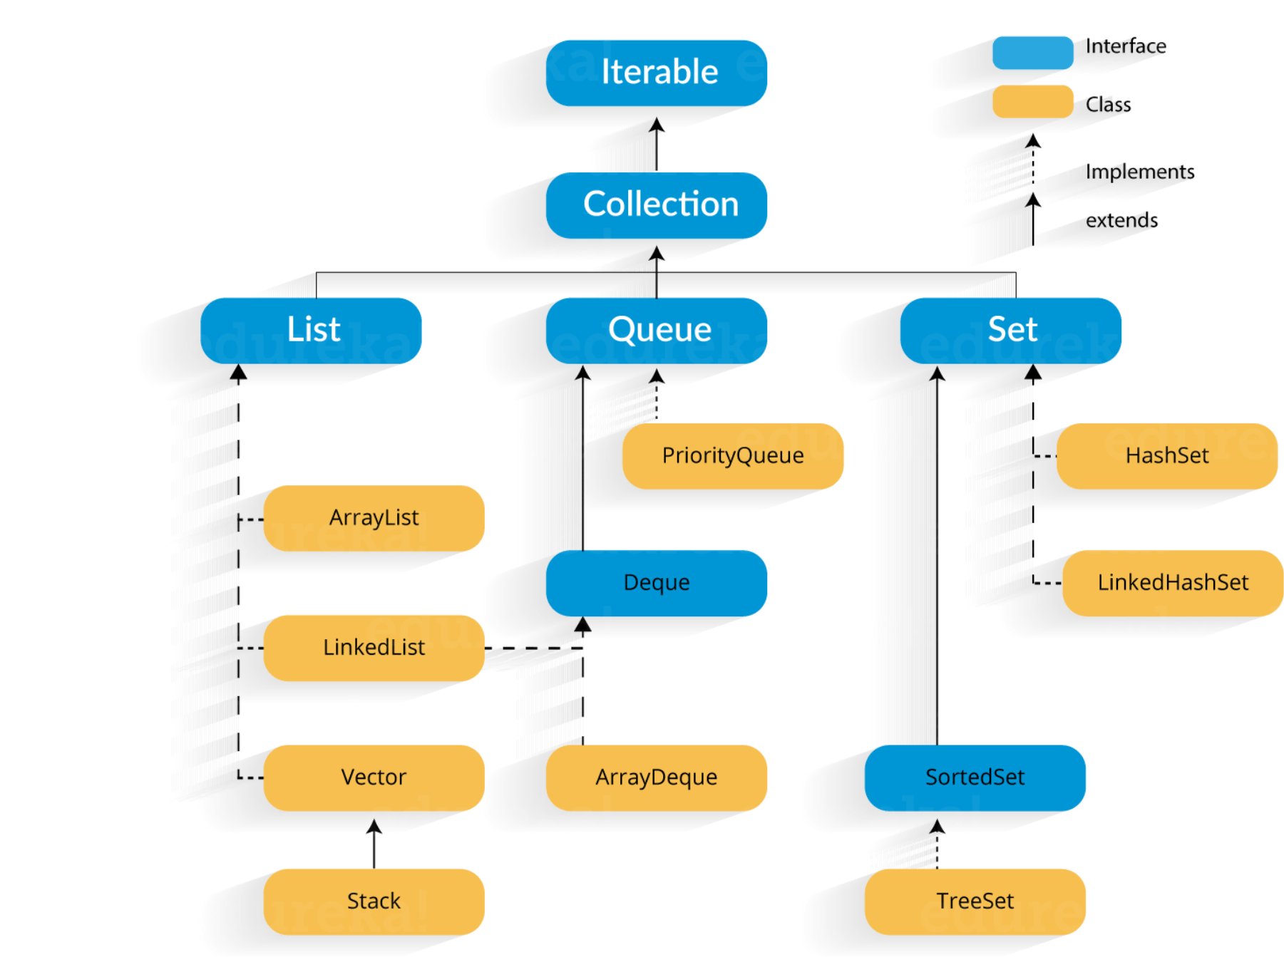
HIERARCHY OF COLLECTIONS

Slide 12
METHODS OF COLLECTION INTERFACE
public boolean addAll(Collection<? extends E> Used to insert the specified collection elements in the invoking collection.
public void clear()
Removes the total number of elements from the collection.
public Iterator iterator()
It returns an iterator.
public boolean isEmpty()
Checks if collection is empty.
public int hashCode()
It returns the hash code number of the collection.
Etc…

Slide 13
ArrayList
The ArrayList class implements the List interface.
It uses a dynamic array to store the duplicate element of different data types.
The ArrayList class maintains the insertion order and is non-synchronized.
The elements stored in the ArrayList class can be randomly accessed.
“ ArrayList<String> list=new ArrayList<String>();//Creating arraylist
list.add(“A");//Adding object in arraylist
list.add(“B");
/Traversing list through Iterator
Iterator itr=list.iterator();
while(itr.hasNext())
{ System.out.println(itr.next()); } ”

Slide 14
LinkedList
LinkedList implements the Collection interface.
It uses a doubly linked list internally to store the elements.
It can store the duplicate elements. It maintains the insertion order and is not synchronized.
In LinkedList, the manipulation is fast because no shifting is required.
Syntax:
LinkedList<datatype> name=new LinkedList<datatype>();
Example:
” LinkedList<String> al=new LinkedList<String>();
al.add(“testing");
al.remove(“testing"); ”

Slide 15
Vector
Vector uses a dynamic array to store the data elements. It is similar to ArrayList.
However, It is synchronized and contains many methods that are not the part of Collection framework.
Example: “ Vector<String> v=new Vector<String>();
v.add(“1");
v.add(“2");
Iterator<String> itr=v.iterator();
while(itr.hasNext())
{
System.out.println(itr.next());
} “

Slide 16
Stack
The stack is the subclass of Vector.
It implements the last-in-first-out data structure, i.e., Stack.
The stack contains all of the methods of Vector class and also provides its methods like boolean push(), boolean peek(), boolean push(object o), which defines its properties.
Example:
“Stack<String> stack = new Stack<String>();
stack.push(“first element");
stack.push(“second element");
stack.pop();
Iterator<String> itr=stack.iterator();
while(itr.hasNext()){
System.out.println(itr.next()); } “

Slide 17
Priority Queue
The Priority Queue class implements the Queue interface.
It holds the elements or objects which are to be processed by their priorities.
Priority Queue doesn't allow null values to be stored in the queue.
“PriorityQueue<String> queue=new PriorityQueue<String>();
queue.add("Amit Sharma");
queue.add("Vijay Raj");
queue.add("JaiShankar");
System.out.println("head:"+queue.element());
System.out.println("head:"+queue.peek());
System.out.println("iterating the queue elements:");
queue.remove();
queue.poll();
System.out.println("after removing two elements:");
Iterator<String> itr2=queue.iterator();
while(itr2.hasNext()){
System.out.println(itr2.next()); ”

Slide 18
Deque - ArrayDeque
Deque interface extends the Queue interface.
In Deque, we can remove and add the elements from both the side.
Deque stands for a double-ended queue which enables us to perform the operations at both the ends.
ArrayDeque class implements the Deque interface.
It facilitates us to use the Deque. Unlike queue, we can add or delete the elements from both the ends.
ArrayDeque is faster than ArrayList and Stack and has no capacity restrictions.
“Deque<String> deque = new ArrayDeque<String>();
deque.add(“plants");
deque.add(“bushes");
deque.add(“trees");
//Traversing elements
for (String str : deque) {
System.out.println(str);
}”

Slide 19
HashSet
HashSet class implements Set Interface.
It represents the collection that uses a hash table for storage.
Hashing is used to store the elements in the HashSet. It contains unique items.
“HashSet<String> set=new HashSet<String>();
set.add("Ravi");
set.add("Vijay");
set.add(“Kamal");
set.remove("Ajay");
//Traversing elements
Iterator<String> itr=set.iterator();
while(itr.hasNext()){
System.out.println(itr.next()); } ”

Slide 20
LinkedHashSet
LinkedHashSet class represents the LinkedList implementation of Set Interface.
It extends the HashSet class and implements Set interface.
Like HashSet, It also contains unique elements.
It maintains the insertion order and permits null elements.
“LinkedHashSet<String> set=new LinkedHashSet<String>(); ”
Instead of <String>, any datatype can be passed on as the variable’s datatype.
The stored LinkedHashSet can be retrieved using an iterator or using for loop.

Slide 21
TreeSet
SortedSet is the alternate of Set interface that provides a total ordering on its elements.
The elements of the SortedSet are arranged in the increasing (ascending) order.
The SortedSet provides the additional methods that inhibit the natural ordering of the elements.
Java TreeSet class implements the Set interface that uses a tree for storage.
Like HashSet, TreeSet also contains unique elements.
However, the access and retrieval time of TreeSet is quite fast. The elements in TreeSet stored in ascending order.
“ TreeSet<String> set=new TreeSet<String>(); ”

Slide 22
Comparable…CompareTo Interface
Java Comparable interface is used to order the objects of the user-defined class.
This interface is found in java.lang package and contains only one method named compareTo(Object).
It provides a single sorting sequence only, i.e., you can sort the elements on the basis of single data member only.
public int compareTo(Object obj):
It is used to compare the current object with the specified object. It returns
positive integer, if the current object is greater than the specified object.
negative integer, if the current object is less than the specified object.
zero, if the current object is equal to the specified object.

Slide 23
Comparator Interface
Java Comparator interface is used to order the objects of a user-defined class.
This interface is found in java.util package and contains 2 methods compare(Object obj1,Object obj2) and equals(Object element).
It provides multiple sorting sequences, i.e., you can sort the elements on the basis of any data member, for example, rollno, name, age or anything else.
Methods:
public int compare(Object obj1, Object obj2)
compares the first object with the second object.
public boolean equals(Object obj)
Used to compare the current object with the specified object.

Slide 24
THANK YOU

